Slide 1

HR Analytics in Power BI
C A S E ST U DY : H R A N A LY T I C S I N POW E R B I

Slide 2
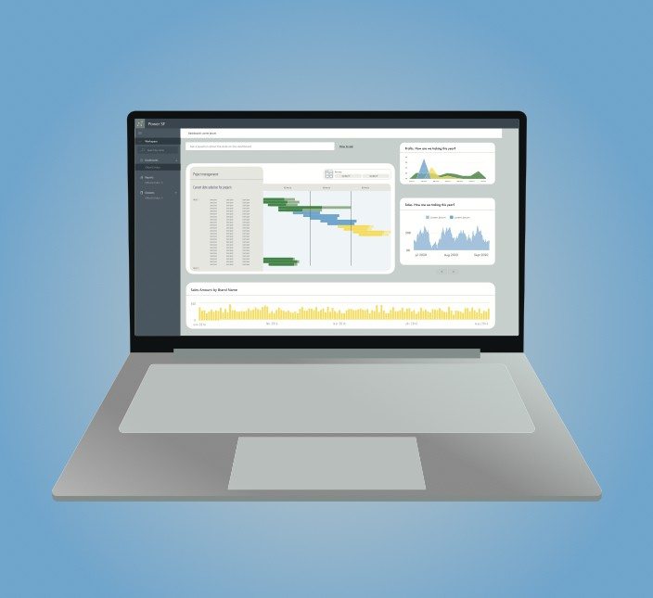
What is a case study?
Apply Power BI skills
Combine previously learned concepts Solve an example real-world problem
Prerequisite courses:
Intermediate DAX in Power BI Data Modelling in Power BI Data Visualization in Power BI

Slide 3
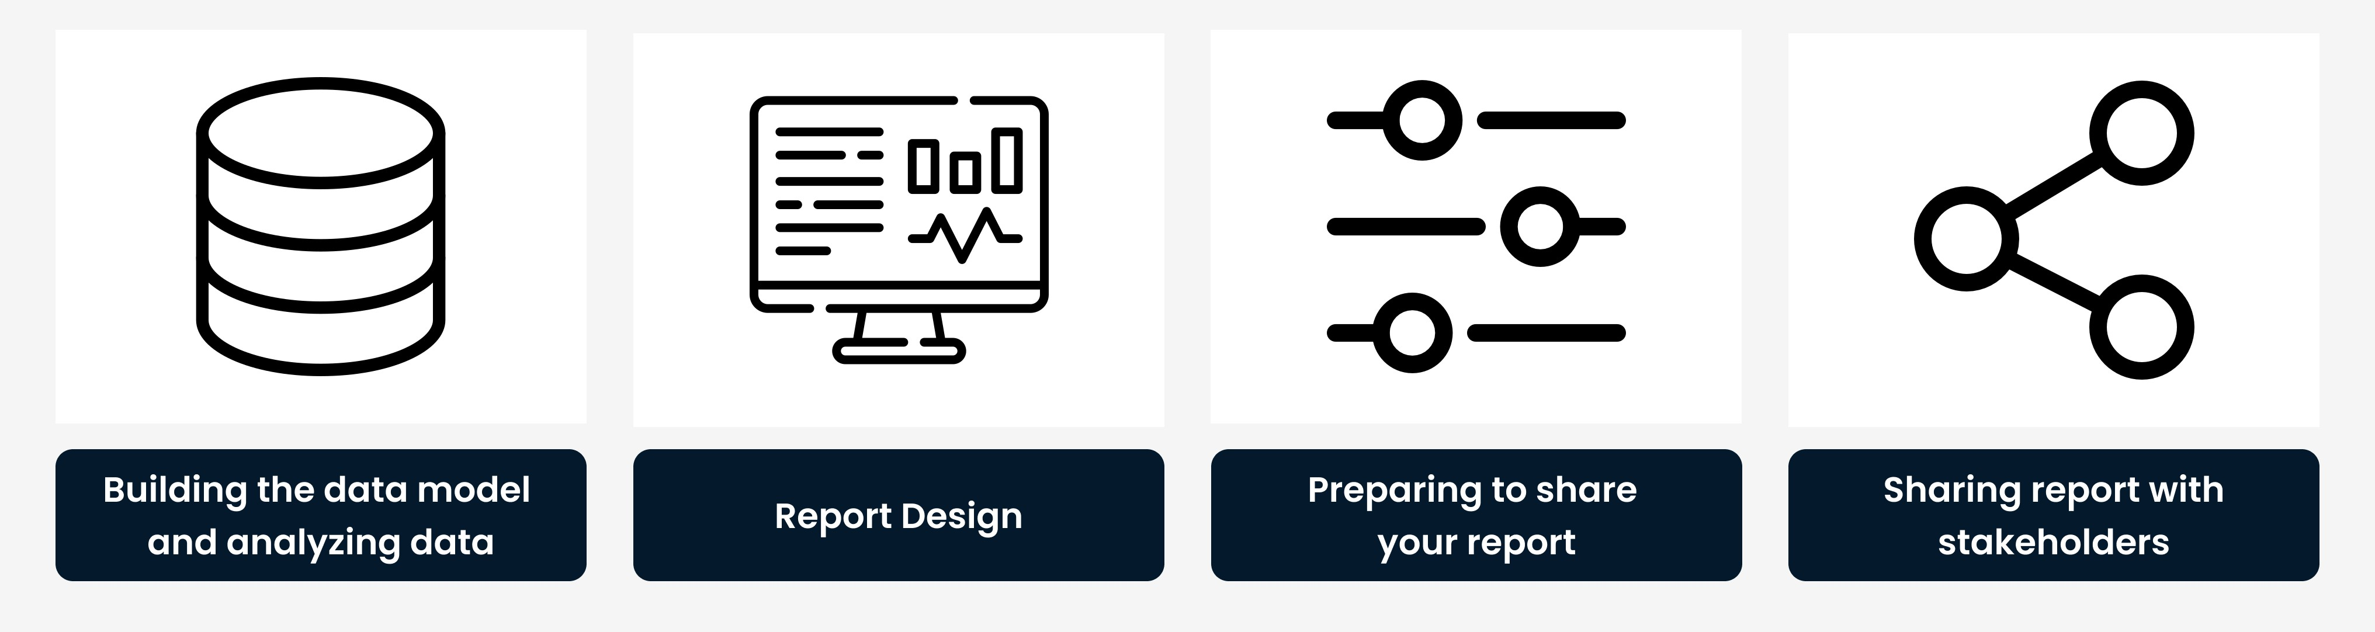
Report development in Power BI
¹ Note: This process applies specifically to developing a report, not to analyzing a dataset.

Slide 4
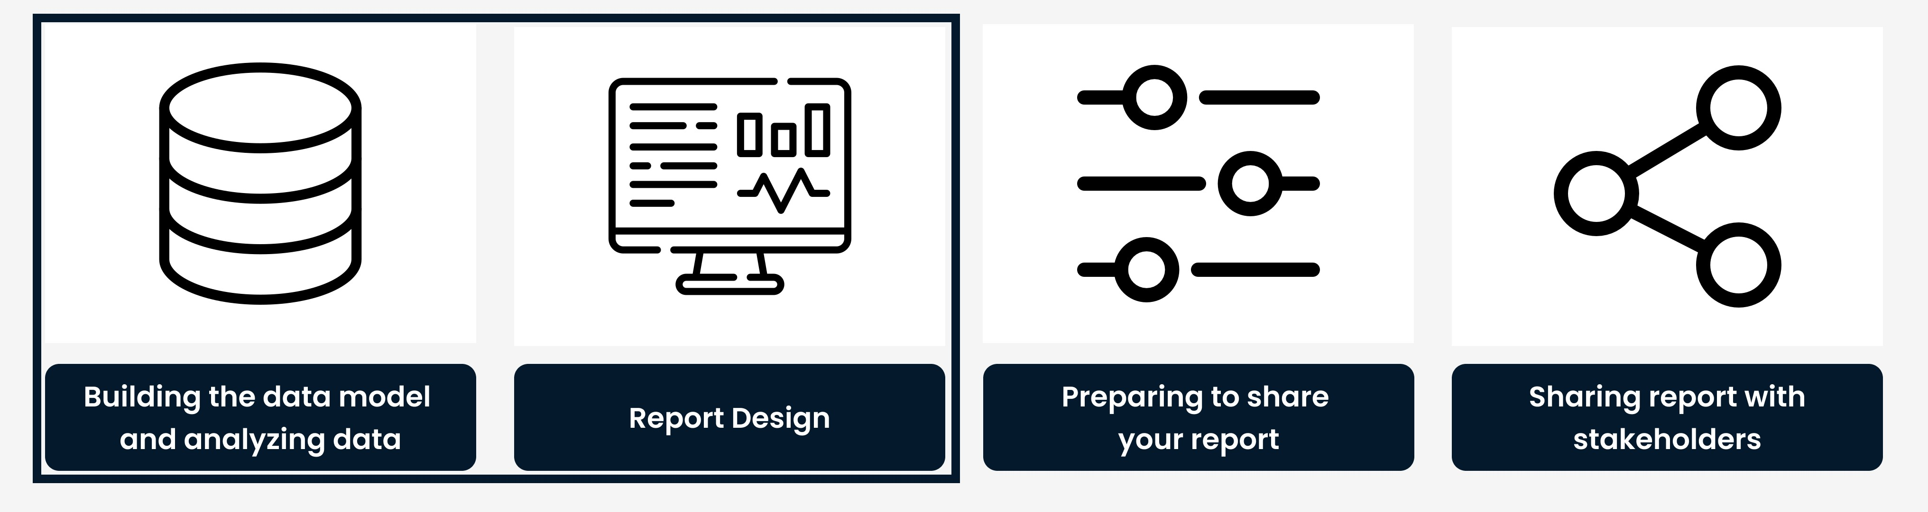
Report development in Power BI

Slide 5
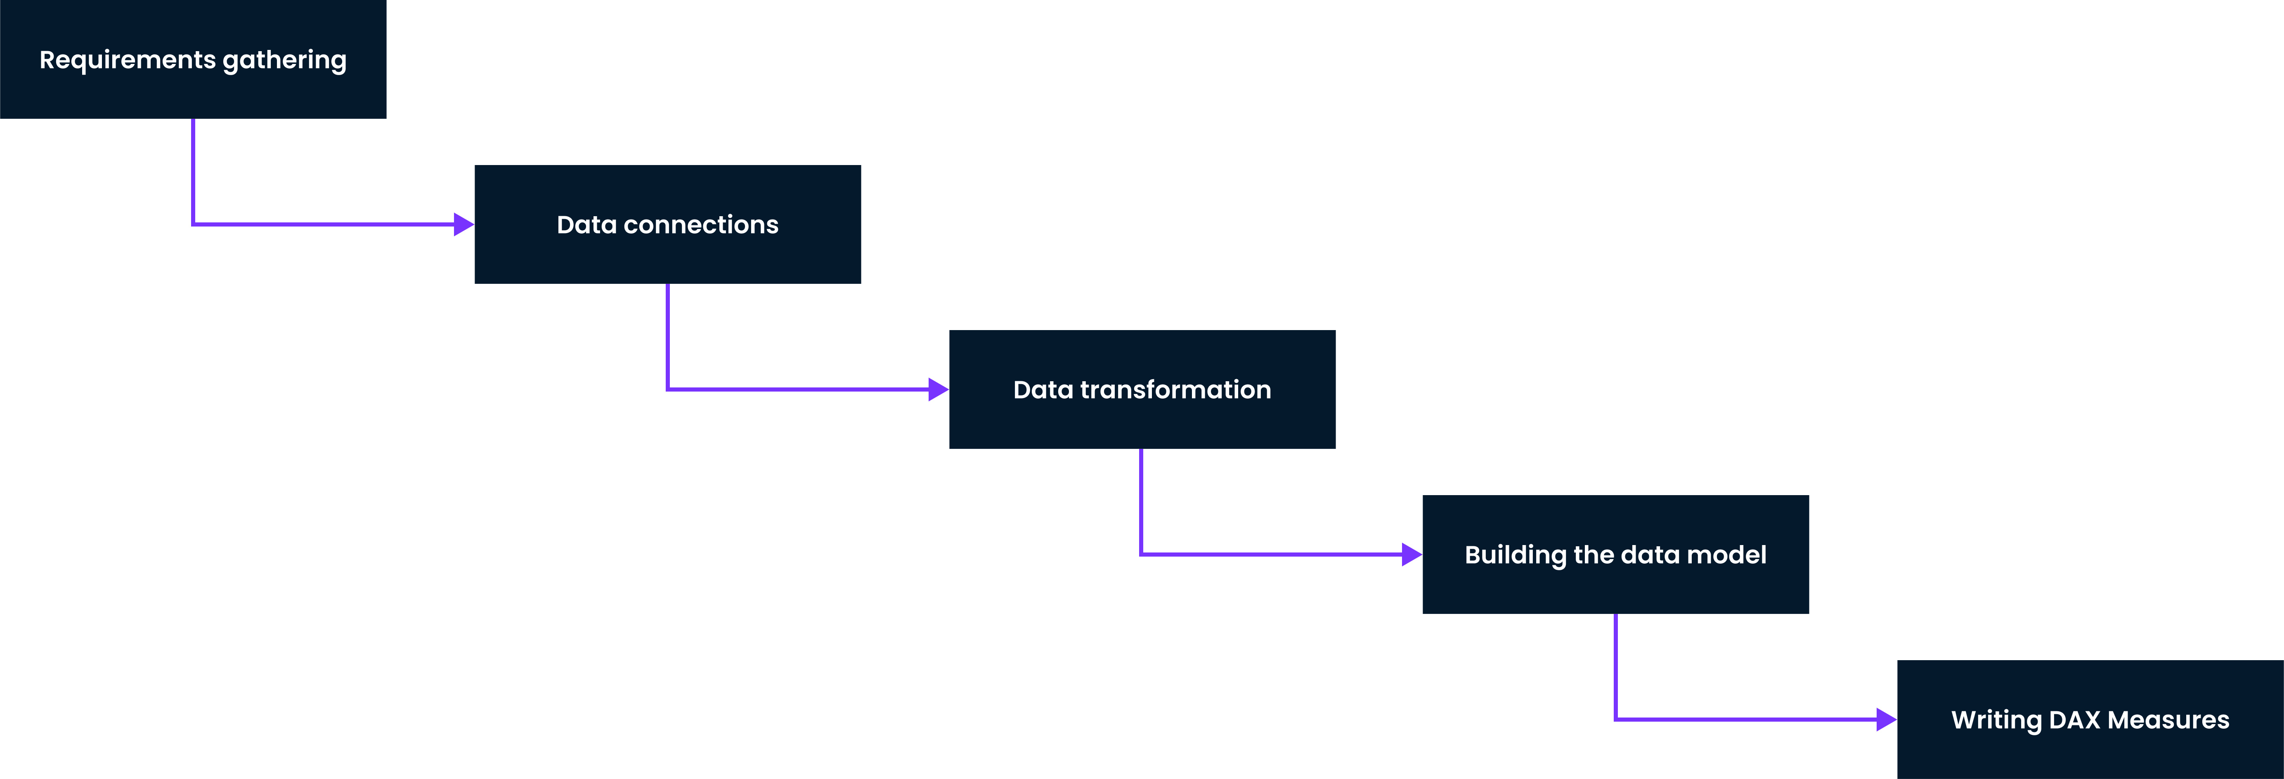
Report development in Power BI

Slide 6
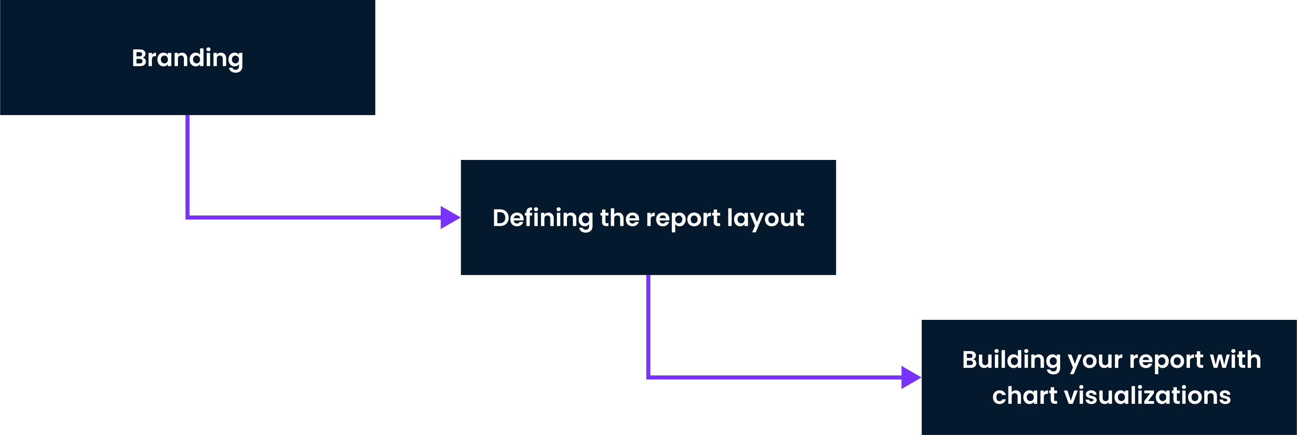
Report development in Power BI

Slide 7

Case study goals
Primary goal: Monitor key HR metrics on employees
Secondary goal: Understand what factors impact attrition

Slide 8
The dataset: Fact table
Column name | Description
PerformanceID | A unique id that identifies a performance review
EmployeeID | A unique ID that identifies an employee. Connects to Employee table.
ReviewDate | Date an employees' review took place.
EnvironmentSatisfaction | Rating for employees' satisfaction with their environment. Connects to Satisfied Level table.
... | ...

Slide 9
The dataset: Dimension tables
Employee EducationLevel RatingLevel SatisfiedLevel Date

Slide 10
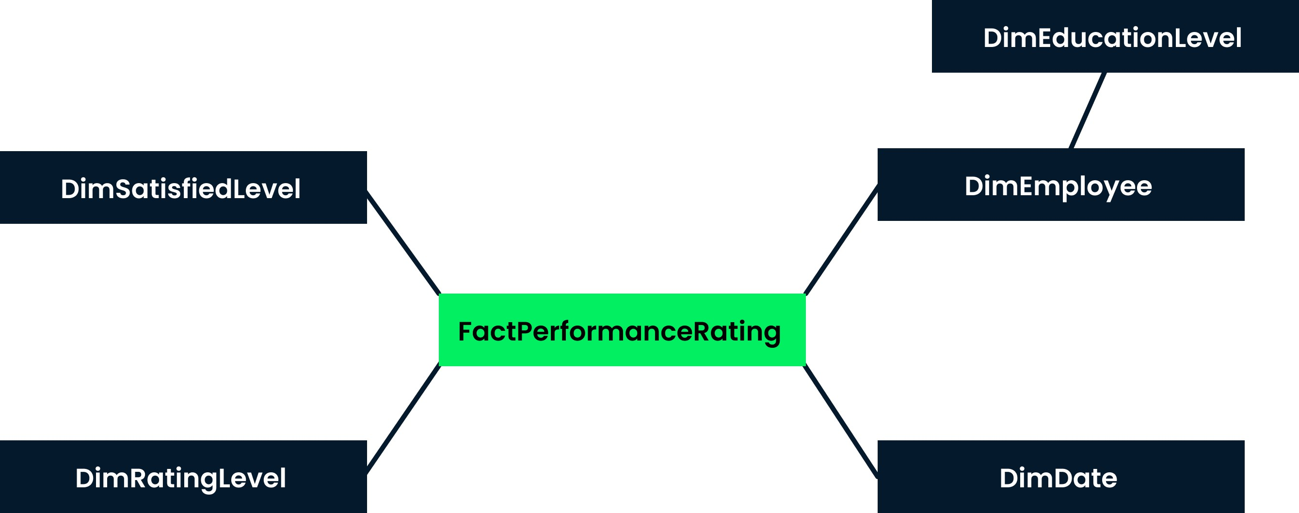
The dataset: Snowflake schema

